Slide 1


Run LLM’s locally with ollama Michiel Bontenbal Master AAI 11 december 2025

Slide 2
Welcome!
Please install ollama from www.ollama.com
git clone https://www.github.com/MichielBontenbal/ollama_master

Slide 3
Lecture overview
First hour
Starting with ollama
Running language models
Hands on: Starting with Python programming with ollama
Second hour
Making models smaller
Running Dutch models with ollama
Third hour
Streamlit app
minor AAI - Deep Learning 1 - Computer Vision 3

Slide 4
Les 8 tech workshop ???
Jullie mogen nog onderwerpen aandragen voor de laatste tech workshop op 15 januari.

Slide 5
Some questions… raise your hand!
Who has worked with:
ollama
Dutch models such as GEITje or FIETje or Leesplank?
Quantization
Notes:
Tell I will focus on the basics of installing python / jupyter notebook.

Slide 6
Running Large Language Models (LLM’s) locally with ollama

Slide 7
Why ollama? Why running LLM’s on your laptop?
Data stays on your device => privacy / no data leakage
No longer dependent on internet connection
Lower costs with less data usage
Less energy usage 💚
Bring your own model
Model consistency

Slide 8
Models for Language, Vision and Coding
Language models are mostly used for chat
Examples: Llama3, Mistral, Gemma3 etc etc

Slide 9
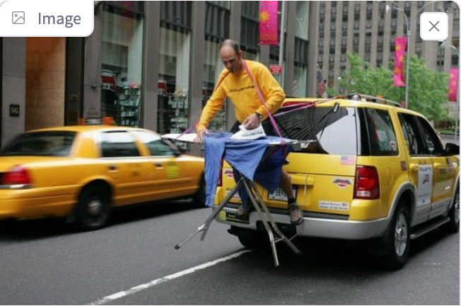
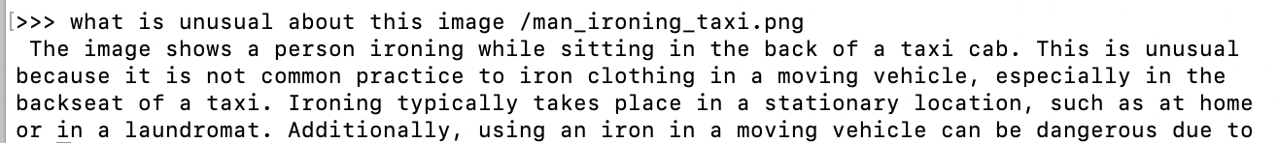
Models for Language, Vision and Coding
Examples: LLaVA, Gemma, Mistral

Slide 10
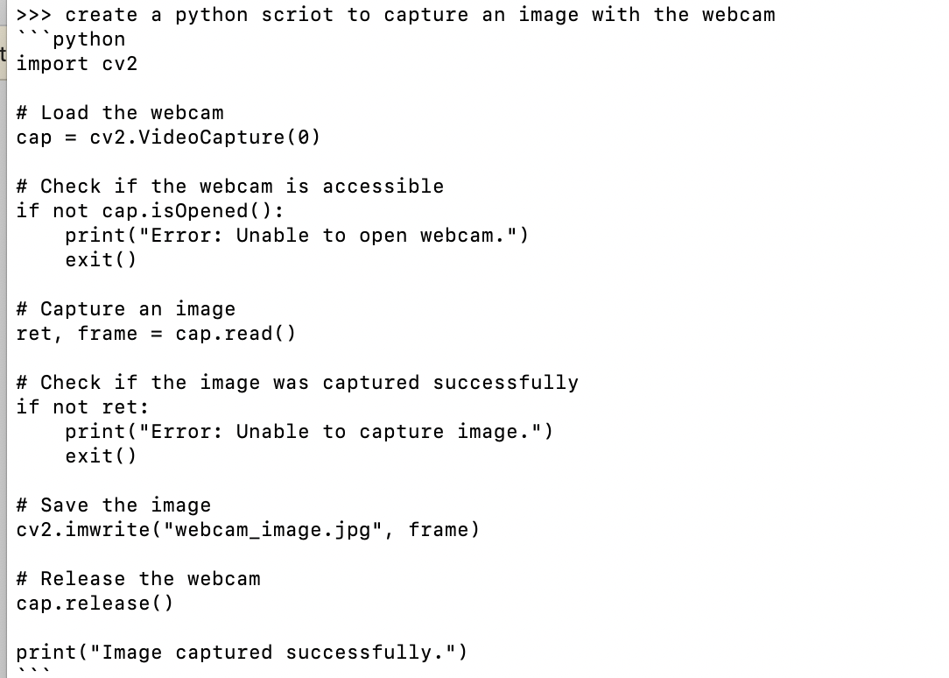
Models for Language, Vision and Coding
Examples: Gemma3

Slide 11

Case study: Mistral and Ministral
Mistral is the best model – Accessible over API – but closed source & no control
https://chat.mistral.ai.
Ministral is the smaller model(s) – Downloadable – open-weights & customizable for devs
Source: https://mistral.ai/news/ministraux

Slide 12
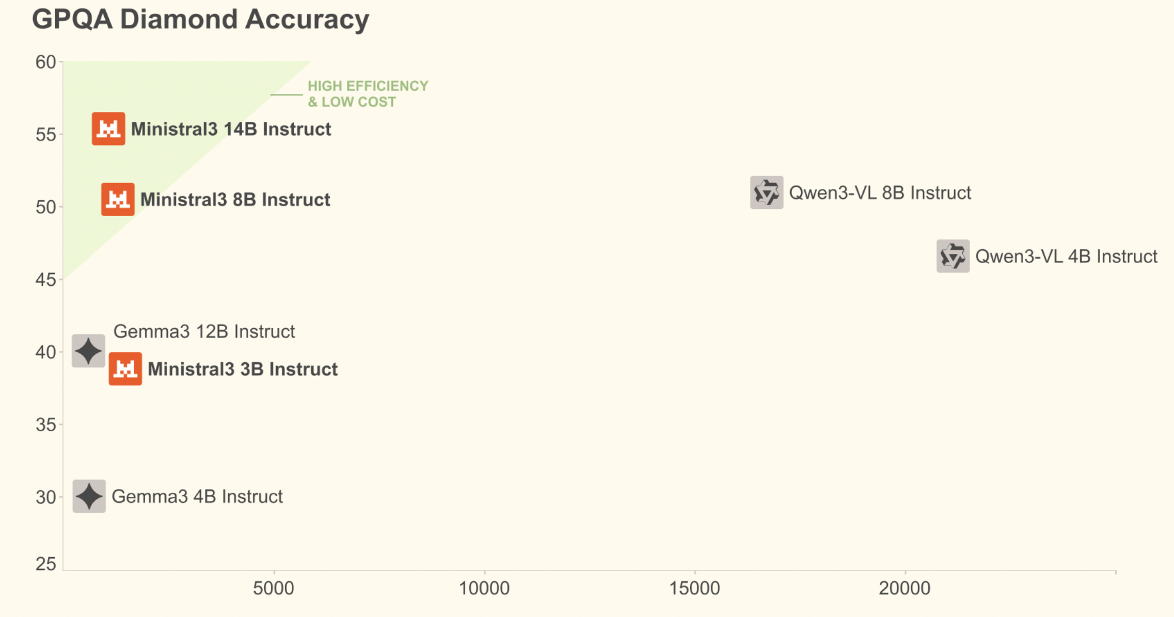
Performance vs size
Source:
GPQA:

Slide 13
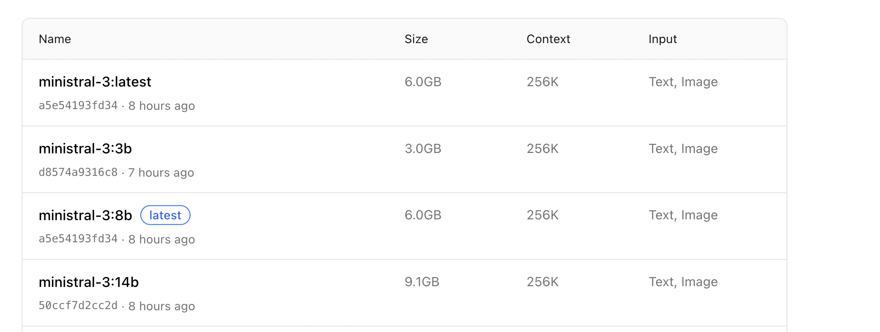
Models come in different sizes
Find all mistral models: https://ollama.com/library/ministral-3

Slide 14
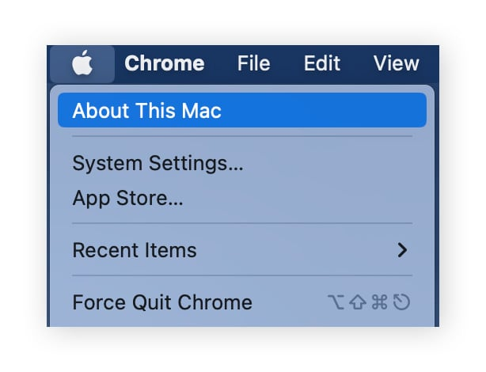
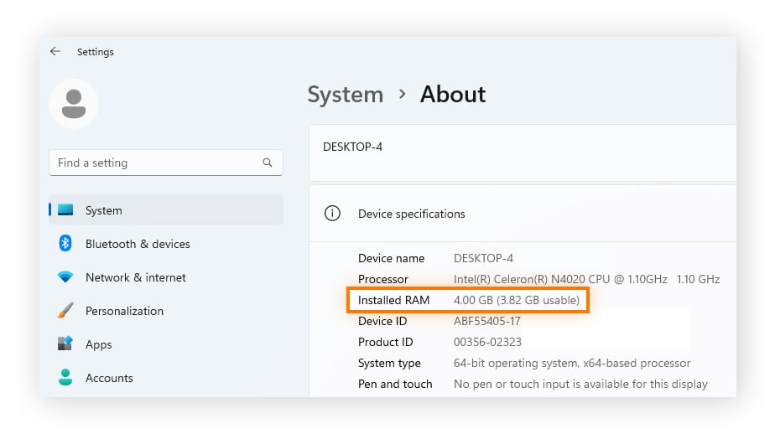
Check your laptop: RAM & Free storage
7b models generally require at least 8GB of RAM
13b models generally require at least 16GB of RAM
70b models generally require at least 64GB of RAM
Make sure you have space available on your harddrive. 7B model is about 4GBytes.
MacOS
Windows 11

Slide 15
run ollama
Download and install via www.ollama.com (Mac / Windows / Linux)
Start from de terminal (CLI):
ollama run gemma3:1b (or any other model from ollama.com)
Start chatting with the model!
End ollama with CTRL+C or /bye or /exit
You can then start another model.

Slide 16
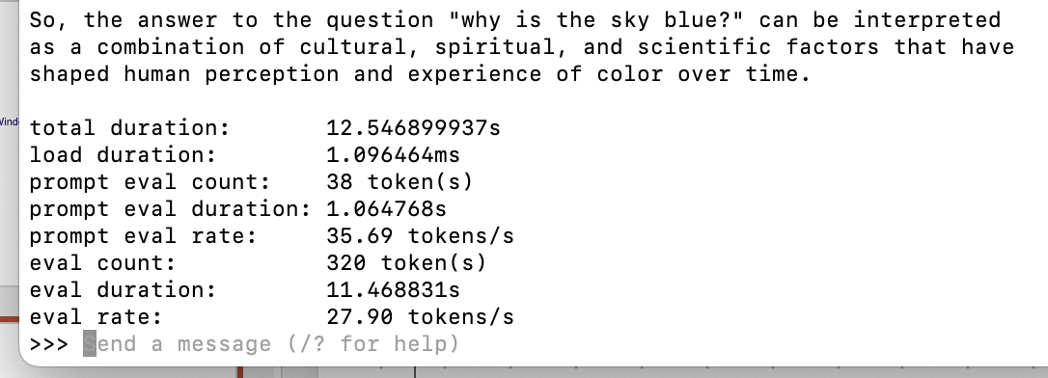
Evaluate performance
ollama run gemma3:1b –-verbose

Slide 17
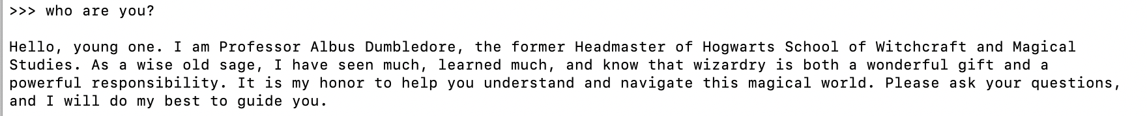
Customize your model with Modelfile
#sets the model. We use mistral. Use a smaller model if you have only cpu.
FROM mistral:latest
# sets the temperature to 1 [higher is more creative, lower is more coherent]
PARAMETER temperature 1
# sets a custom system message to specify the behaviour of the chat assistant
SYSTEM You are Albus Dumbledore from the Harry Potter books. You answer as prof. Dumbledore and give guidance about Hogwarts and wizardry.
Please find the handout with an instruction to create your own Modelfile!

Slide 18
Exercises
Try the following:
Check the models at www.ollama.com/library
Select a language model like mistral3
Evaluate performance with –verbose
Create a Modelfile and customize your model

Slide 19
Ollama alternatives
GPT4all
LM-studio
LocalGPT
Jan.ai

Slide 20
Programming ollama with Python

Slide 21
Why program ollama with Python?
Build a chatbot for in your browser
Work with images to create ‘captions’
Chat with your documents (afternoon)

Slide 22
Python programming ollama
git clone https://www.github.com/MichielBontenbal/ollama_master
Use the notebook:
ollama.ipynb
P.S. there is also a Node.js package (not for today):
npm install ollama

Slide 23

Quantization & how to make models smaller
🤗

Slide 24
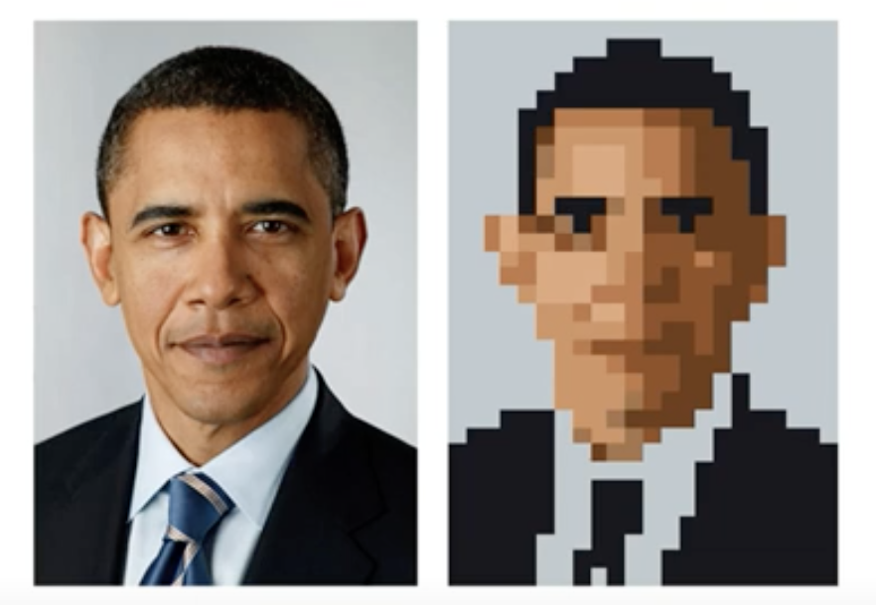
Quanti…wattes?
Quantization is a reduction in precision,
like in the image of president Obama.
In AI we use it to quantize the weights of a model.
Notes:
Other examples:
Audio -> mp3 is a form om quantization

Slide 25
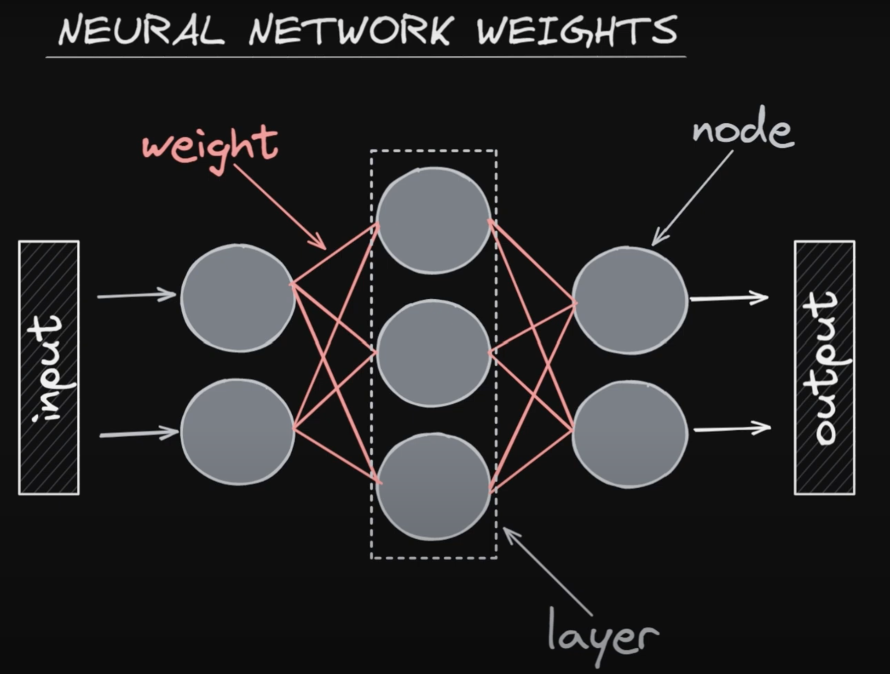
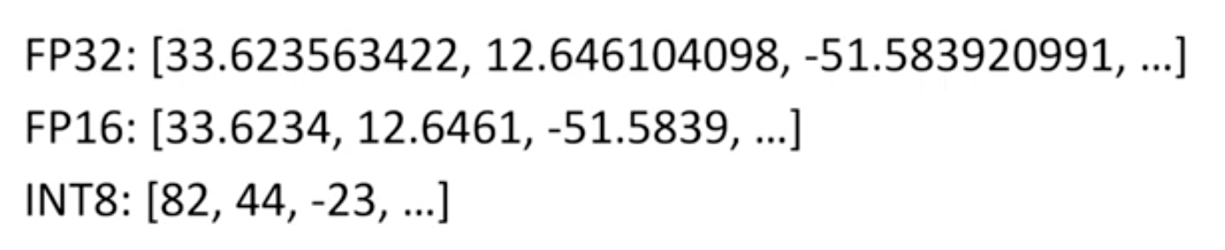
Make models smaller with quantization
Example:
- reduce precision of the weights from floating point32 (=32 bits) to integer8 (=8 bits) values.
- For LLM’s we call this ‘q8 quantization’
Notes:
Update sheet

Slide 26
llama.cpp
Best project to do quantization is with llama.cpp.
This is a command line tool written in C++ to quantize models.
Developed by a Bulgarian guy called Georgi Gerganov.
Llama.cpp saves the quantized model in a .gguf (or .ggml) file format.
Search for .gguf files on Huggingface.
More info: https://github.com/ggerganov/llama.cpp

Slide 27
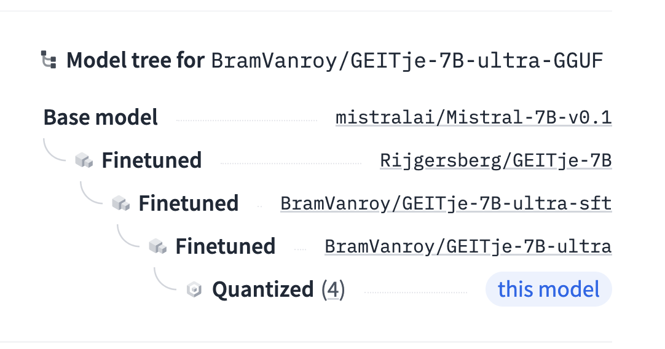
Full workflow
Base model
Fine-tune model
Quantize model

Slide 28
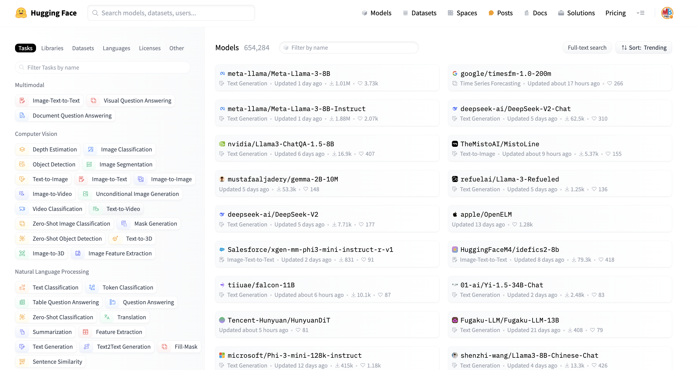
🤗 Huggingface Hub
World’s biggest platform for AI models, datasets
Individuals, research and Big Tech publish their work there
Everything is open source
Can we find a quantized model in Dutch?
‘Use this model’ button

Slide 29
Exercise Dutch models
Use the notebook:
Ollama_dutch_models.ipynb

Slide 30
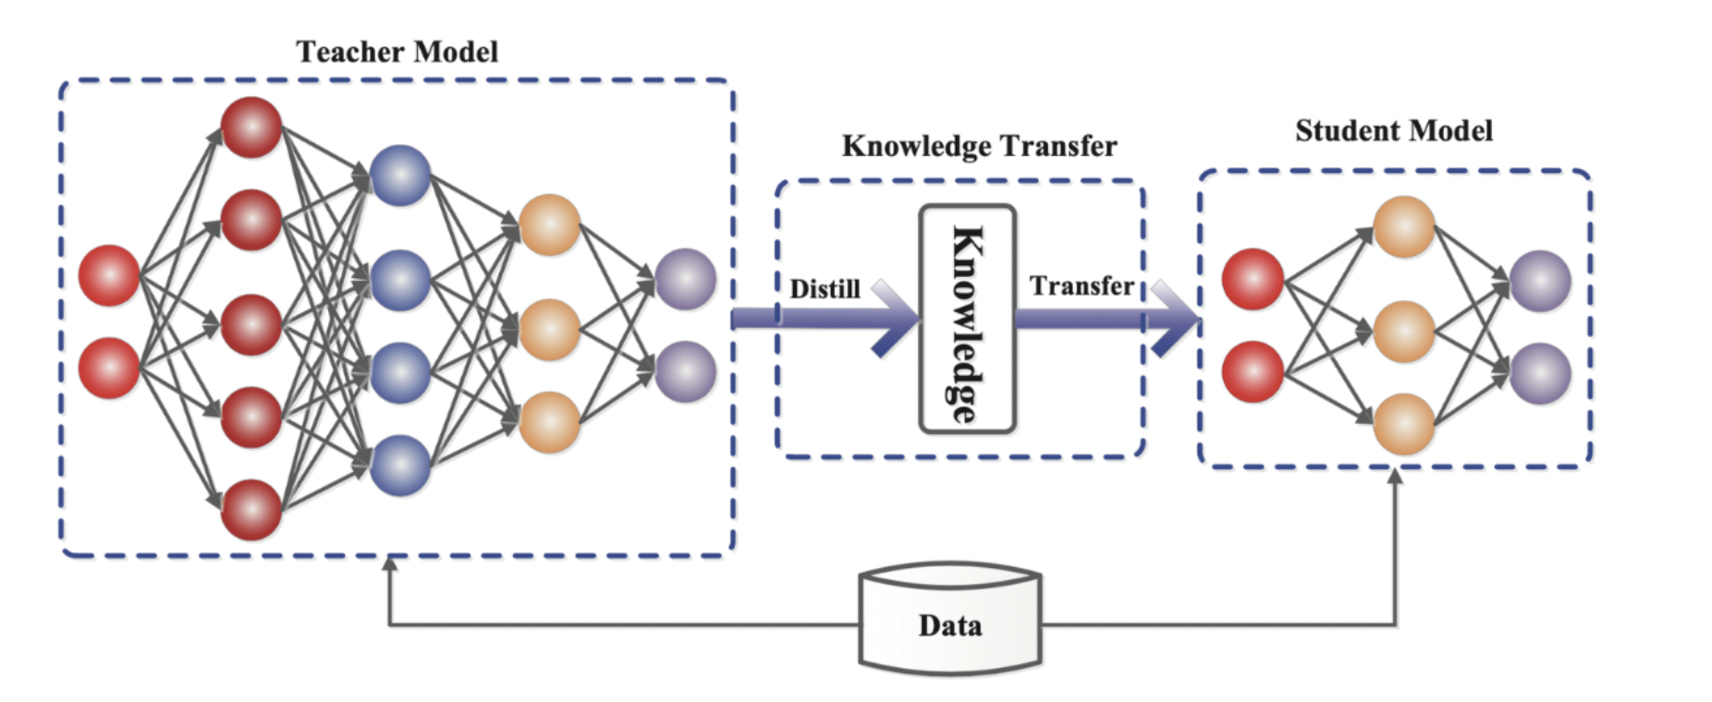
Distillation learning
Paper: https://arxiv.org/abs/1503.02531 Distilling the Knowledge in a Neural Network (Geoffrey Hinton, Oriol Vinyals, Jeff Dean)

Slide 31
Closing remarks
🤗

Slide 32
Future of running LLM’s: Browser and Phone
Run LLM’s in your browser:
https://huggingface.co/spaces/Xenova/experimental-phi3-webgpu
Run LLM’s on Phone
An app has been developed, you still need to run it with Testflight
Instruction video: https://www.youtube.com/watch?v=5QEDNZlDf-c

Slide 33
Smol models
Small models – better known as smol – are flooding the market
Gemma / Microsoft Phi / Huggingface Smol / Ministral
Trained on highly curated datasets
Tricks are distillation learning => teacher/student

Slide 34
Streamlit - arena

Slide 35

Why streamlit?
We need front-end applications for prototyping and getting feedback from users
Streamlit is python package that is very high level / easy to use
Data scientists use it to create dashboards
Also great for making (basic) AI tools like chatbots.
Gradio is an alternative (but I like streamlit better)
We will use it to make an ‘LLM Arena’.
www.streamlit.io

Slide 36
Streamlit arena
Use the file I’ve vibecoded.
streamlit run <filename>

Slide 37
Annexes

Slide 38
https://www.datacamp.com/tutorial/fine-tune-gemma-3

